Slide 1
Part I Syllabus – Fundamental Underlying Layers
Date​ | Subject​ | File​
Week 1:​ 9/Jan/2023​ 11/Jan/2023​ | Introduction: course logistics and Internet history​ | M1-L1-Introduction.pptx​
 | Layered Network Architecture​ | First part of M1-L2-Network Layer & Physical Resilience.pptx​
Week 2:​ 16/Jan/2023​ 18/Jan/2023​ | Physical Layer: Network Resilience​ | Second part of M1-L2-Network Layer & Physical Resilience.pptx​
 | Data link layer – Flow control​ | M1-L3-DLL-Flow Control.pptx​
Week 3:​​ 25/Jan/2023​ | Data link layer – Error control​ | M1-L4-DLL-Error Control.pptx​
Week 4:​ 30/Jan/2023​ 01/Feb/2023​ | Local area network – Introduction​ | M1-L5-LAN-Introduction.pptx​
 | Local area network – MAC​ | M1-L6-LAN-MAC.pptx​
Week 5:​ 06/Feb/2023​ 08/Feb/2023​ | Local area network – Ethernet​ | First part of M1-L7-LAN-Ethernet.pptx​
 | Local area network – Ethernet Evolutions​ | Second part of M1-L7-LAN-Ethernet.pptx​
Week 6:​ 13/Feb/2023​ 15/Feb/2023​ | Local area network – WLAN​ | M1-L8-LAN-WLAN.pptx​
 | Mobile Access Networks | M1-L9-Mobile.pptx
Week 7: 20/Feb/2023 22/Feb/2023 | E-learning for Network paradigms | M1-L10-Paradigms.pptx
 | Reviewing all contents taught in previous lectures

Slide 2
Additional Materials
The related content talked today in https://eclass.teicrete.gr/modules/document/file.php/TP326/%CE%98%CE%B5%CF%89%CF%81%CE%AF%CE%B1%20(Lectures)/Computer_Networking_A_Top-Down_Approach.pdf is as follow:
Chapter 5
https://www.techtarget.com/searchnetworking/definition/local-area-network-LAN

Slide 3
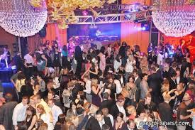
Mingling Among a Cocktail party

Slide 4
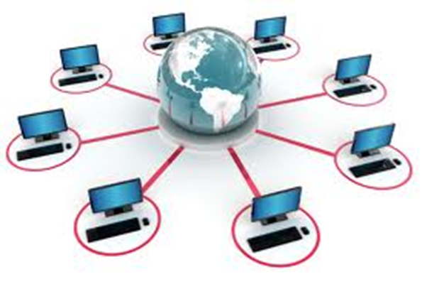
SC2008/CZ3006/CE3005 ​ Computer Network
Lecture 5
Local Area Network (LAN): Introduction

Slide 5
Contents
Local Area Network
Definition and Taxonomy
Protocol Architecture
LAN Topologies
Bus, Tree, Ring and Star
Choice of topology
Transmission Media
Medium Access Control
Functions and Features
Static Channel Allocation
Dynamic Channel Allocation

Slide 6
Local Area Network (LAN)

Slide 7
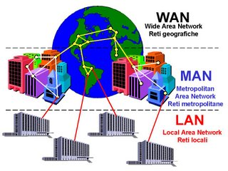
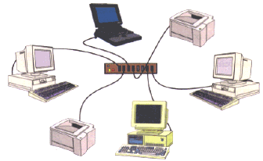
WAN/MAN/LAN
Not Examinable
hierarchical structure

Slide 8
LAN (Local Area Networks)
Not Examinable
LAN is a computer network that covers a small area (home, office, building, campus)
a few kilometers
LANs (usually) do not involve leased lines; cabling and equipments belong to the LAN owner.
LAN consists of
Shared transmission medium
not so valid today due to switched LANs
regulations for orderly access to the medium
set of hardware and software for the interfacing devices

Slide 9
LAN Taxonomy
Not Examinable
FDDI
Ethernet
Token ring
Wireless LAN
random access
token passing
polling
MAC
protocols
bus
star
ring
tree
products
topologies
Local Area Networks
standard
bodies
transmission
media
fiber
twisted pair
coax
wireless
ANSI
IEEE 802

Slide 10
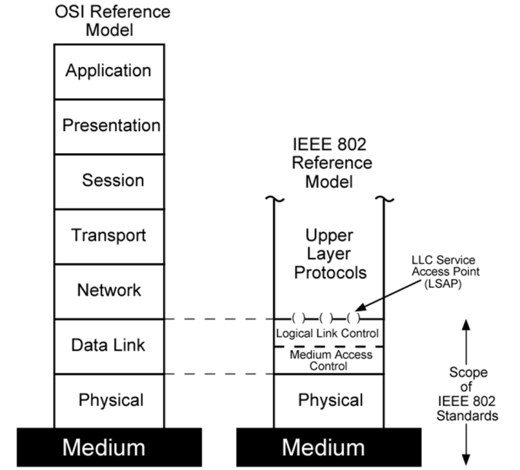
LAN Protocol Architecture
Not Examinable
Corresponds to lower two layers of OSI model
But mostly LANs do not follow OSI model
Current LANs are most likely to be based on Ethernet protocols developed by IEEE 802 committee
IEEE 802 reference model
Logical link control (LLC)
Media access control (MAC)
Physical

Slide 11
IEEE 802 Layers - Physical
Not Examinable
Signal encoding/decoding
Preamble generation/removal
for synchronization
Bit transmission/reception
Specification for topology and transmission medium
WiFi (Wireless Fidelity) vs. LiFi (Light Fidelity)

Slide 12
IEEE 802 Layers - DLL
Not Examinable
OSI layer 2 (Data Link) is divided into two in IEEE 802
Logical Link Control (LLC) layer
Medium Access Control (MAC) layer
LLC layer
Interface to higher levels
flow control, error control
Based on classical Data Link Control Protocols (so we have already covered it earlier)
MAC layer
Prepare data for transmission
Error detection
Address recognition
Govern access to transmission medium
Not found in traditional layer 2 data link control

Slide 13
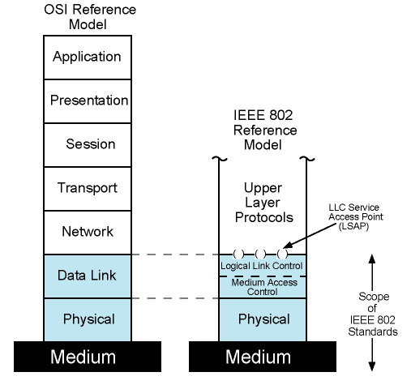
IEEE 802 Protocols vs OSI Model
Not Examinable

Slide 14
LAN in a Nutshell
Not Examinable
IEEE 802.2
Logical Link Control Protocol
802.3 802.4 802.5 802.6 802.11 802.12 802.14
CSMA Token Token DQDB CSMA Round HFC
/CD Bus Ring /CA Robin
Coax Coax UTP Fiber Radio UTP Coax
UTP Fiber STP Infrared
STP Fiber
Fiber
B,T,S B,T,S R DB --- S, T T
Physical Data Link
MAC LLC
used by
Ethernet
used by
WiFi
Topologies (see next slide): Bus, Tree, Star, Ring, DualBus

Slide 15
LAN Topologies
Not Examinable

Slide 16
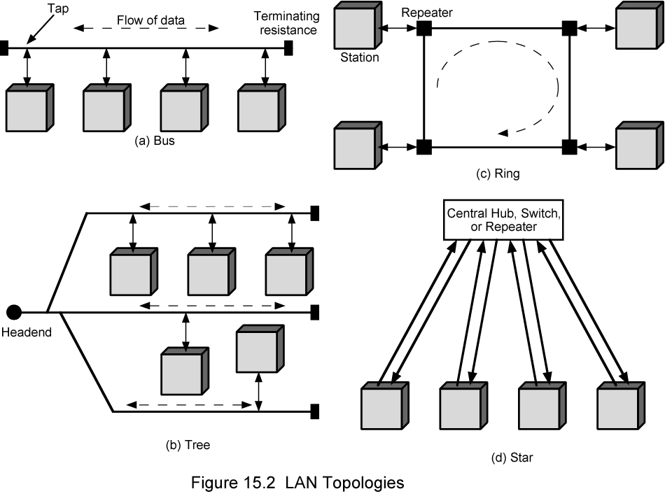
LAN Topologies: Bus, Tree, Ring and Star
Not Examinable

Slide 17
Bus and Tree
Not Examinable
Multipoint medium
Transmission propagates throughout medium
Heard by all stations
Need to identify target station
Each station has unique address
Full duplex connection between station and tap
Allows for transmission and reception
Need to regulate transmission
To avoid collisions
If two stations transmit at same time, signals overlap
To avoid continuous transmission from a single station.
Solution: Transmit Data in small blocks – frames
Terminator absorbs frames at end of medium

Slide 18
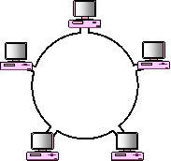
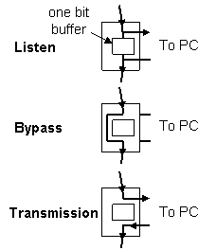
Ring Topology
Not Examinable
Repeaters are joined by point to point links in closed loop
Receive data on one link and retransmit on another
Links are unidirectional
Stations attach to repeaters
Data Frames
Circulate past all stations
Destination recognizes address and copies frame
Frame circulates back to source where it is removed
Medium access control determines when station can insert frame

Slide 19
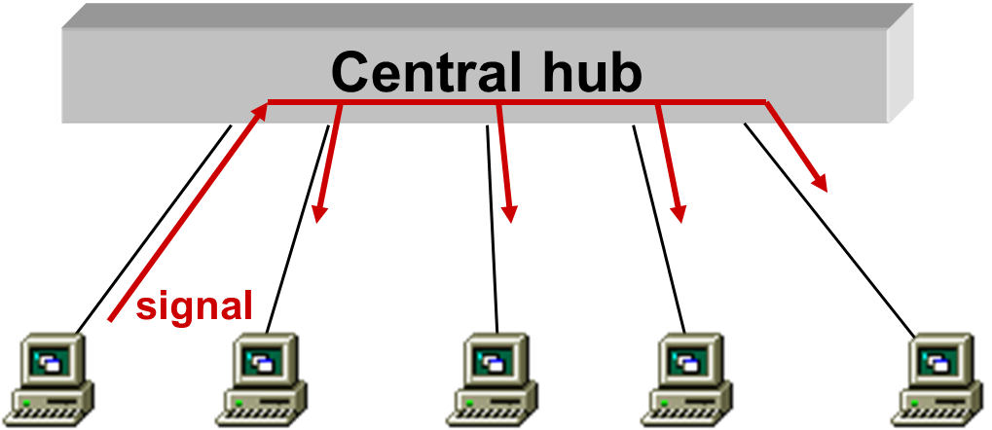
Star Topology
Not Examinable
Each station connected directly to central node
using a full-duplex (bi-directional) link
Central node can broadcast (hub)
Physical star, but logically like bus since broadcast
Only one station can transmit at a time; otherwise, collision occurs
Central node can act as frame switch
retransmits only to destination
today’s technology

Slide 20
Choice of Topology
Not Examinable
Reliability
Expandability
Performance
Needs considering in context of:
Medium
Wiring layout
Access control

Slide 21
Transmission Medium
Not Examinable

Slide 22
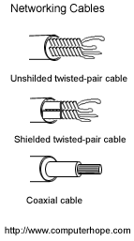
Medium Available (1)
Not Examinable
Voice grade unshielded twisted pair (UTP)
Cat 3/ Cheap
Well understood
Use existing telephone wiring in office building
Low data rates
Shielded twisted pair (STP) and baseband coaxial
More expensive than UTP but higher data rates
Broadband cable
Still more expensive and higher data rate

Slide 23
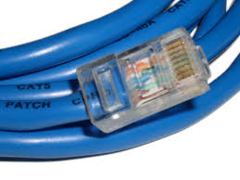
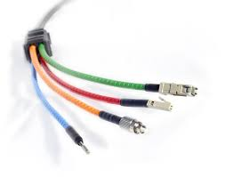

Media Available (2)
Not Examinable
High performance unshielded twisted pair (UTP)
Cat 5 and above (5e and 6)
High data rate for small number of devices
Switched star topology for large installations
Optical fiber
Electromagnetic isolation
High capacity
Small size
High cost of components
High skill needed to install and maintain
Wireless Channel
Fading channel

Slide 24
Media Access Control (MAC)

Slide 25
Media Access Control
Assembly of data into frame with address and error detection fields
Disassembly of frame
Address recognition
Error detection
Govern access to transmission medium
Not found in traditional layer 2 data link control
For the same LLC, several MAC options may be available

Slide 26
MAC Decision Making Options
Where?
Central
Greater control
Simple access logic at station
Avoids problems of co-ordination
Single point of failure
Potential bottleneck
Distributed
How?
Synchronous (static) solutions
Specific capacity dedicated to connection
Asynchronous (dynamic) solutions
In response to demand

Slide 27
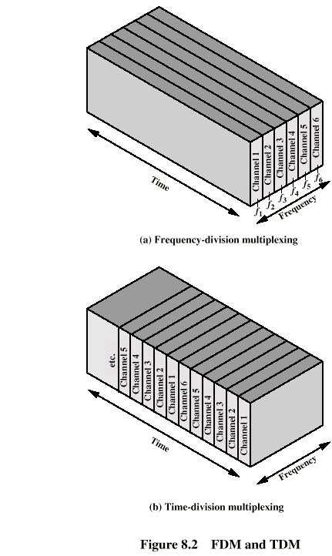
Static Channel Allocation
Not Examinable
Time Division Multiplexing (TDM)
Each user is statically allocated one time slot
if a particular user does not have anything to send, that period is wasted
User may not utilize the whole channel for a time slot
Frequency Division Multiplexing (FDM)
Channel is divided to carry different signals at different frequencies
Efficient if there is a constant (one for each slot) amount of users with continous traffic
Code Division Multiplexing (CDM)
TDM
FDM

Slide 28
Dynamic Channel Allocation (1)
Not Examinable
Round robin
Each station has a turn to transmit
declines or transmits up to a certain data limit
overhead of passing the turn in either case
Performs well if many stations have data to transmit for most of the time
otherwise passing the turn would cause inefficiency
Reservation
It is used for stream traffic, where time on the medium is divided into slots, much as with TDM.
Reservation can be made in centralized or distributed fashion.

Slide 29
Dynamic Channel Allocation (2)
Not Examinable
Contention
All stations contend to transmit
No control to determine whose turn is it
Stations send data by taking risk of collision (with others’ packets)
however they understand collisions by listening to the channel, so that they can retransmit
Several implementation methods: Aloha, CSMA, etc
In general, good for bursty traffic
Typical traffic types for most networks
Efficient under light or moderate load
Performance is bad under heavy load

Slide 30
Learning Objectives
Local Area Network
Functions of each layer: physical, LLC and MAC
802 Protocol family
LAN Topologies
Frame transmission over Bus, Tree, Ring and Star
Transmission Media
Medium Access Control
Pros and Cons of Static Channel Allocation
Comparison among Dynamic Channel Allocation

